Slide 1
Classical Big Data Systems: HDFS (Data Lake), Apache Hadoop, Apache Pig and Apache HIVE
Dr. Guido Möser

Slide 2
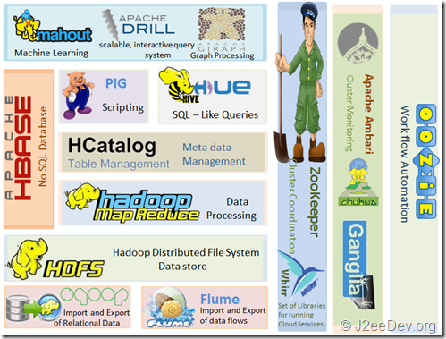

Slide 3
What is Apache Hadoop? – Apache Hadoop Fundamentals
Imagine the following scenarios:
You have ...
Volume | Processing
1 GB | Desktop PC
10 GB | Desktop PC
100 GB | Desktop PC?
1 TB | Scale up! Workstation? Multicore-Systems
10 TB | Hadoop and related eco-systems
100 TB | Hadoop and related eco-systems
1 PB | Hadoop and related eco-systems

Slide 4
Virtual Machine: Ubuntu 18.04.x LTS 64-bit Desktop

Slide 5
Available Software
HDFS in Pseudo-distributed mode
Apache Hadoop
Apache Pig
Apache HIVE
MySQL
Sqoop
Python
pySpark
Juypter Notebooks
R
RStudio
Feel free to install additional software packages:
- Hue (will offer a web frontend to run SQL-like Queries in Apache Pig and Apache Hive
- …

Slide 6
System Requirements
8, better 16 GB memory on host
Virtualization supported by CPU
>= 4 cores
AMD XEN/Ryzen or Intel i5/i7
>= 40 GB diskspace

Slide 7
Running Hadoop Jobs
We will run Hadoop in Single Mode and Pseudo-distributed mode
Single Modes
1
Standalone (or local) mode
There are no daemons used in this mode.
Hadoop uses the local file system as an substitute for HDFS file system.
The jobs will run as if there is 1 mapper and 1 reducer.
Distributed Modes
2
Pseudo-distributed mode
All the daemons run on a single machine and this setting mimics the behavior of a cluster.
All the daemons run on your machine locally using the HDFS protocol.
There can be multiple mappers and reducers.
3
Fully-distributed mode
This is how Hadoop runs on a real cluster.

Slide 8
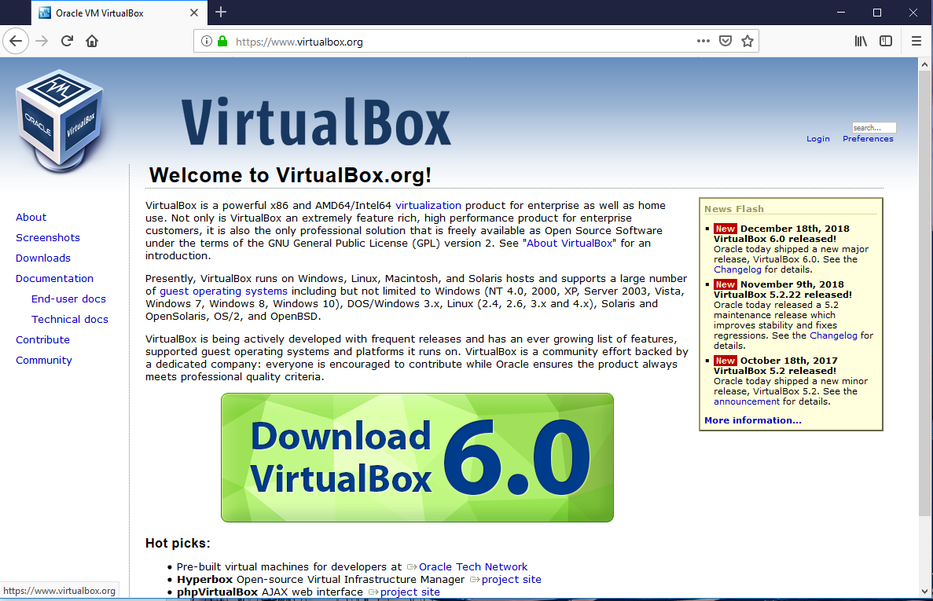
Oracle Virtual Box: Resources
Notebooks provided by htw: should already be installed!
Please select latest version!

Slide 9
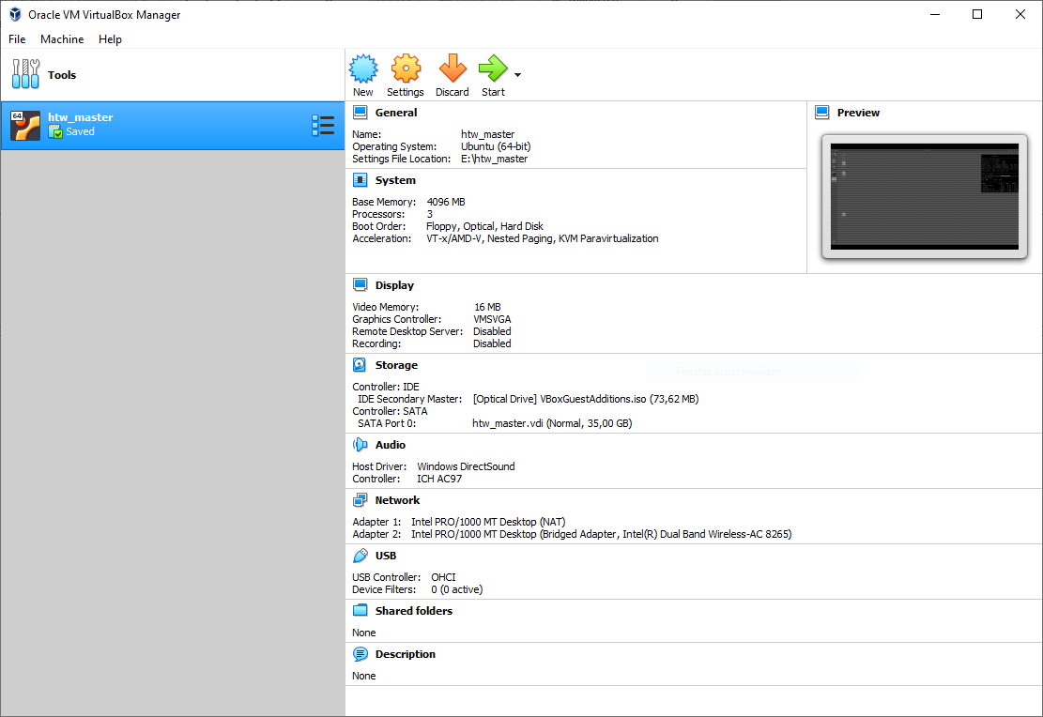
Import VM Image
Menu > File > Import Appliance…

Slide 10
VM: Change the settings
System Tab: Motherboard > Base Memory ~ 4 GB (more is better)
System Tab: Processor > Processor(s) ~ 2 (more is better)
Check Network Settings, switch them on and off and on again (helps in most cases)
Shared Folder: Feel free to set one.

Slide 11
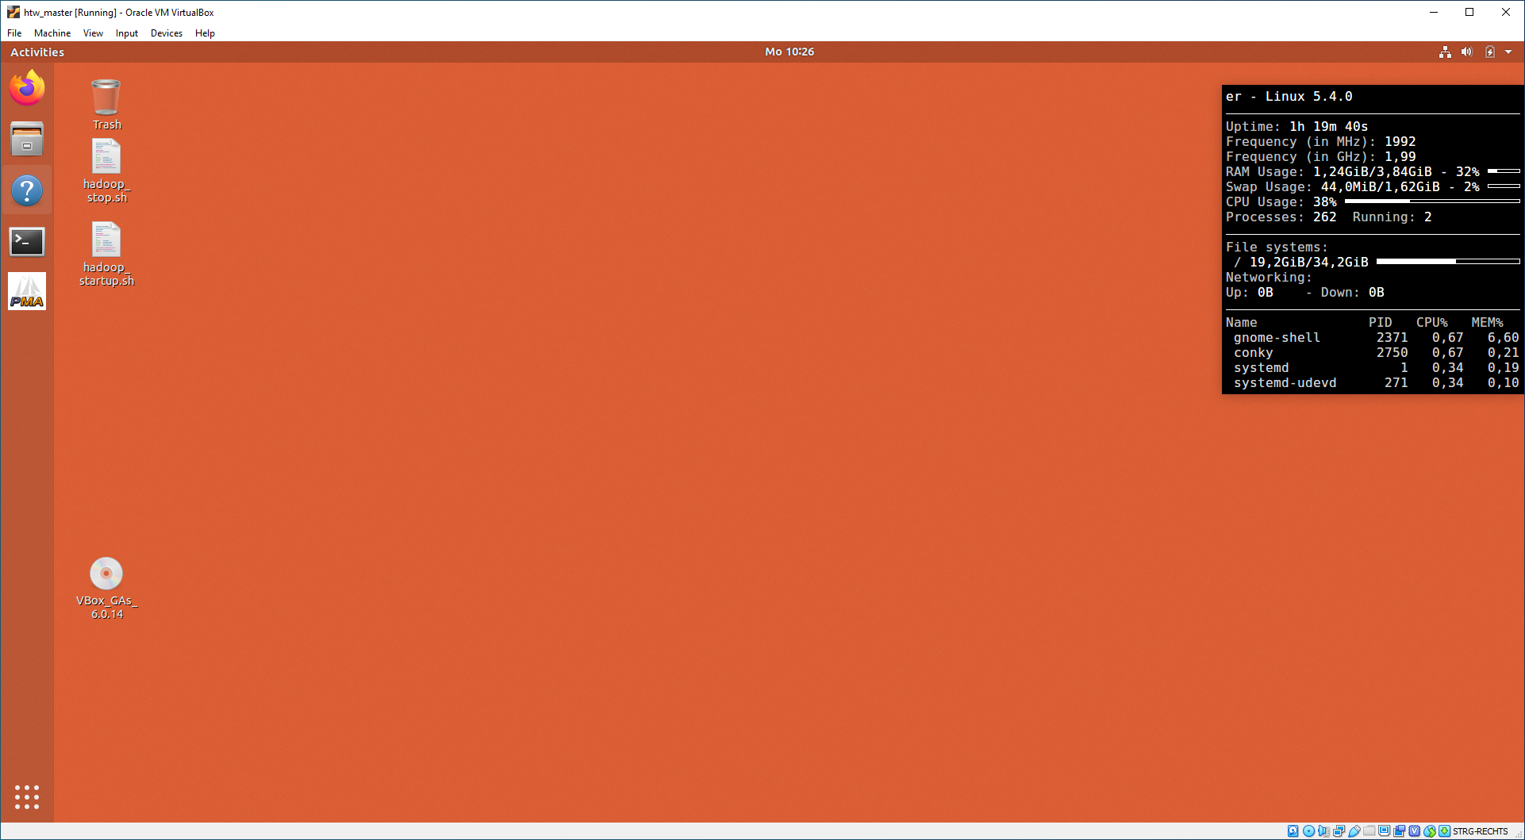
Start the Virtual Machine!

Slide 12
IP-Addresses
Please check both the host machine IP address and the guest machine IP address. Both machines should be in the same address-room!
MAC / Ubuntu (Linux) / Windows: Enter ifconfig or ipconfig
Ubuntu: Enter sudo ifconfig
Check if the internet is working fine in your guest-machine (Ubuntu 18.04 LTS). If so, go ahead!

Slide 13
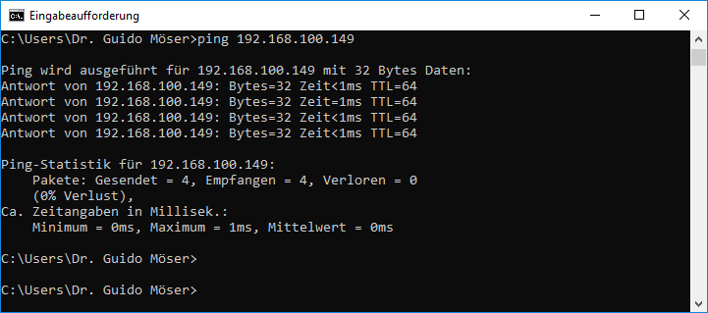
Win Host-System: ping IP guest (Ubuntu) address from host (here: Win10)
192.168.100.149 is guest machine’s IP address!

Slide 14
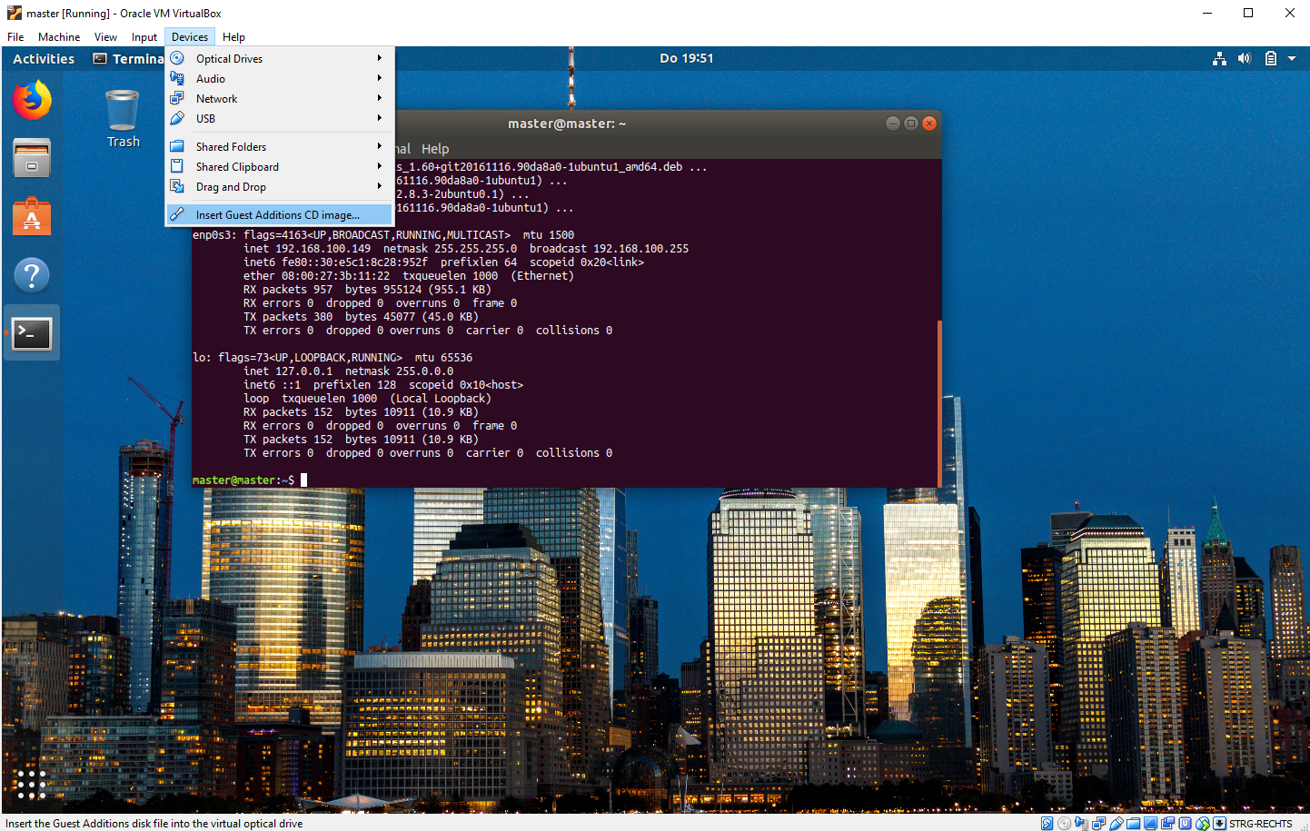
Install Guest-Edition
If you are doing it first time, installation process will run – be patient!

Slide 15
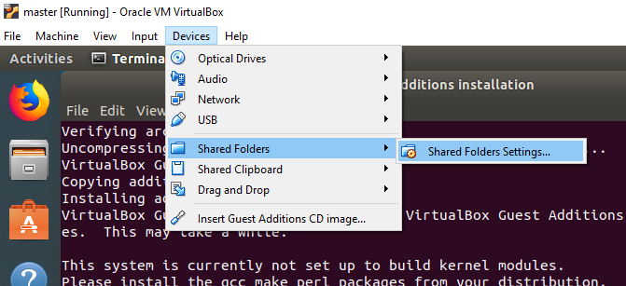
Shared Clipboard / Drag and Drop / Shared Folder
Shared Clipboard and Drag and Drop should already working bidirectionally!
Shared Folders must be enabled first.

Slide 16
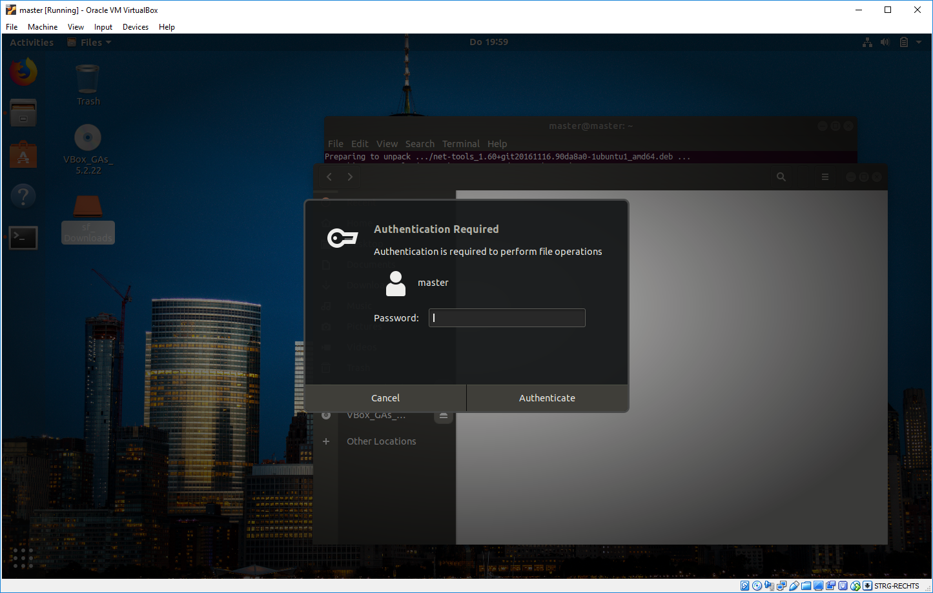
Shared Folder
Shared Folder (sf_name.of.shared.folder) should appear on Ubuntu desktop. Double click and enter your password.

Slide 17
Shared Folder
To add the shared folder permanentely, enter the following commands in Ubuntu console:
sudo usermod –G vboxsf –a htw
# restart the system!
sudo shutdown –r now

Slide 18
Setup Ubuntu: System Update
Optional: Never touch a running system! So don’t do that if it is not absolutely necessary!
Update Ubuntu
> sudo apt-get update
> sudo apt-get dist-upgrade
> sudo apt-get install
> sudo apt-get autoclean
> sudo apt-get autoremove
Please note: You can also use the GUI update tool to run the update process!
Reference: https://wiki.ubuntuusers.de/apt/apt-get/

Slide 19
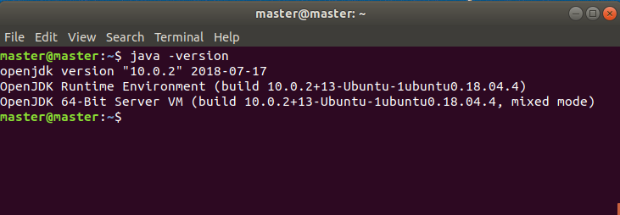
System Checks: Check java-Version

Slide 20
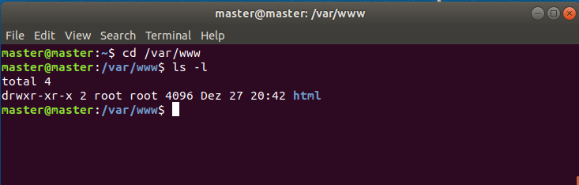
System Checks: LAMP: Check /var/www/ folder
Jump into the /var/www/ folder:

Slide 21
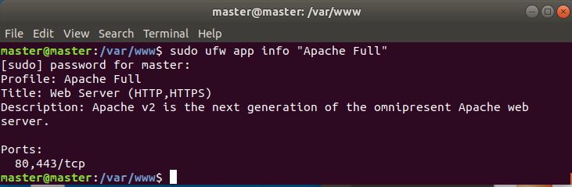
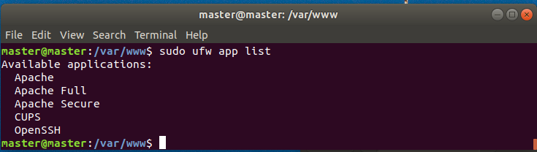
System Checks: Check Apache and Firewall
Port 80 and 443 is open (TCP)
Also run: sudo ufw app list
Notes:
sudo ufw allow in "Apache Full"

Slide 22
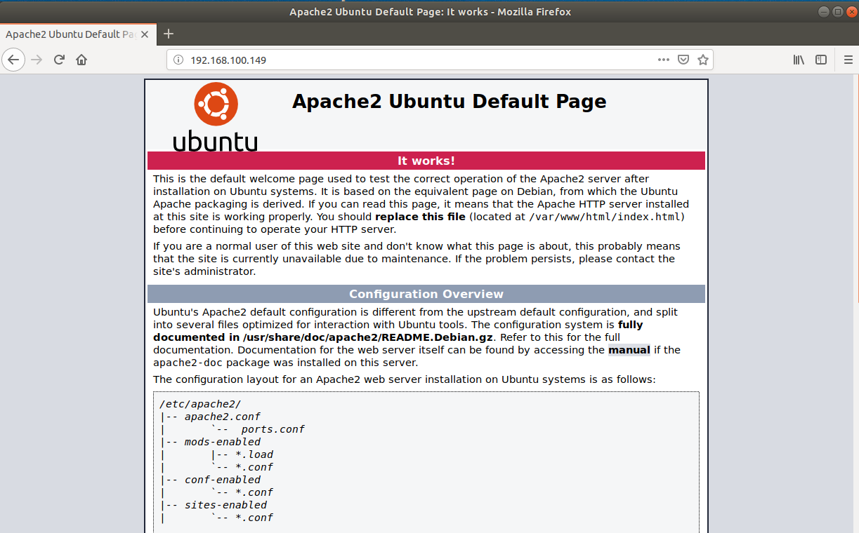
System Checks: Default Ubuntu 18.04 Apache web page: Guest-Machine

Slide 23
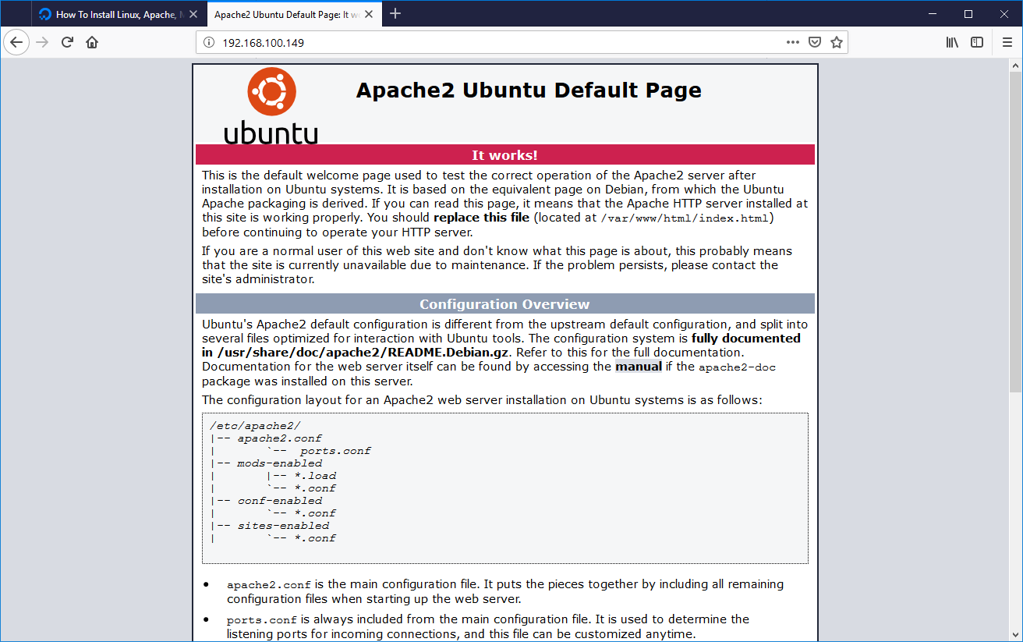
System Checks: Default Ubuntu 18.04 Apache web page from outside: Host

Slide 24
System Checks: Check MySQL
Use phpMyAdmin alternatively!
MySQL (or another database) is required to learn SQL and to run HIVE (metadata storage)
Login into MySQL:
Credentials:
User: root
PW: password
> mysql –u root -p
Notes:
sudo ufw allow in "Apache Full"

Slide 25
Please set up and check your system!
Session / Exercise

Slide 26
Final System Setup
Checklist
Try to do as much of the following steps on the console!
Please check your system
(Restart your system several times)
Check if java is available
Check if the shared folder is available
Check if your system is connected to the internet!
Webserver should be reachable from inside and outside!
Update your system
Find out where your personal folder is (cd ~)
Check some helpful unix-shell-commands
…
I will assist you in case of problems!

Slide 27
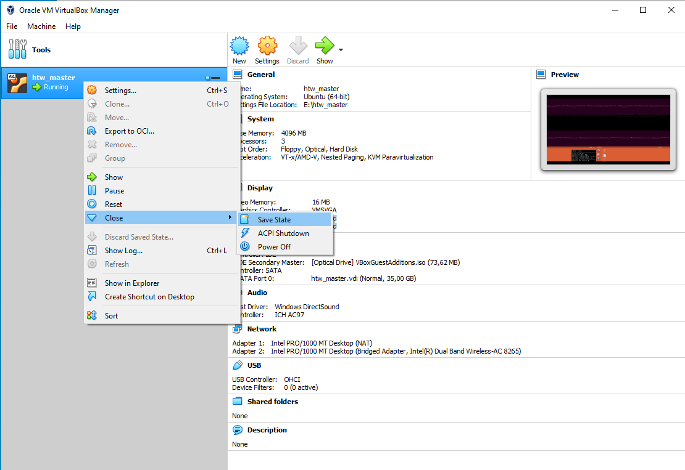
How to shut the Virtual Machine Down: Use Save State!!

Slide 28
Hadoop – single mode

Slide 29
Run hadoop!
Ubuntu Console
# run hadoop in folder /usr/local/hadoop/bin/hadoop
cd /usr/local/hadoop/bin
./hadoop
# check if everything works fine
./hadoop version
The 2nd command (./hadoop version) is important – it validates that Java is available in Hadoop!

Slide 30
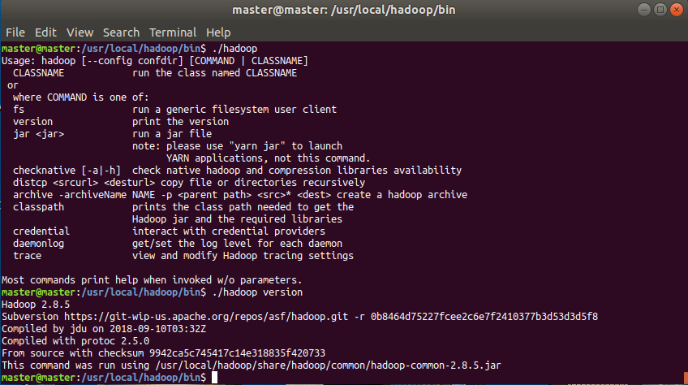
Run Hadoop and Check Version!
This tells you the path to the jar-file: This command was run using /usr/local/hadoop/share/hadoop/common/hadoop-common-2.9.2.jar

Slide 31
Hadoop Jobs (Single Mode)

Slide 32
Please note!
Hadoop on your Virtual Machine is already set to Pseudo-distributed mode! If you want to run the following example without your HDFS, download and install Hadoop in another folder or use parameter -fs!

Slide 33
First Hadoop-Job: Examples
To see which examples are available, run:
hadoop jar /usr/local/hadoop/share/hadoop/mapreduce/hadoop-mapreduce-examples-2.9.2.jar
Some examples:
wordcount: hadoop jar /usr/local/hadoop/share/hadoop/mapreduce/hadoop-mapreduce-examples-2.8.5.jar wordcount
wordmean/wordmedian/wordstandarddeviation
grep
Sudoku: ☺

Slide 34
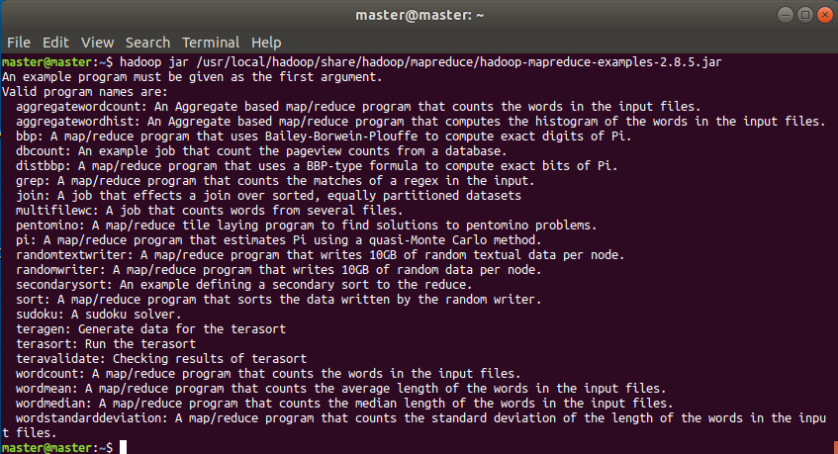
First Hadoop-Job: Available Examples

Slide 35
Hadoops core job: MAP REDUCE: Wordcount

Slide 36
MapReduce Word Count Process
Demonstration: Example in Hadoop-System
Input
Splitting
Mapping
Shuffling
Reducing
Final Result
cat, 1
mat, 1
cat, mat
cat, (1)
cat, 1
cat, sat, mat, dog, lay, mat
cat, 1
dog, 1
…
mat, 2
…
sat, 1
dog, 1
sat, (1)
dog, 1
sat, dog
…
…
lay, 1
mat, 1
lay, mat
mat, (1,1)
mat, 2
…

Slide 37
MapReduce Word Count Process
Exercise: Please fill out the exmpty boxes and run the example in your own Hadoop system and check the results!
Input
Splitting
Mapping
Shuffling
Reducing
Final Result
…, …
…, …
…, …
Deer Bear River
…, (…,…)
…, …
Deer Bear River Car Car River Deer Car Bear
…, …
…, …
…, …
…, …
…, …
…, …
…, …
…, (…,…,…)
…, …
Car Car River
…, (…,…)
…, …
…, …
…, …
…, …
Dear Car Bear
…, (…,…)
…, …

Slide 38
Inputs and Outputs
The MapReduce framework operates exclusively on <key, value> pairs:
The framework views the input to the job as a set of <key, value> pairs;
The framework produces a set of <key, value> pairs as the output of the job, conceivably of different types.
Input and Output types of a MapReduce job:
(input) <k1, v1> -> map -> <k2, v2> -> combine -> <k2, v2> -> reduce -> <k3, v3> (output)
Documentation: https://hadoop.apache.org/docs/stable/hadoop-mapreduce-client/hadoop-mapreduce-client-core/MapReduceTutorial.html

Slide 39
Hadoop: Word Count - Comments
Hadoop Map / Reduce jobs are implemented (unfortunately) in JAVA!
JAVA is not an easy programming language: (1) .java code has to be compiled into bit-code (*.jar); (2) It is like C* and users need some experience to work with it!
We will review some parts of the Java-Code, but please refer to the official Hadoop Tutorial!
Instead of setting up own reduce/map java-programs, users can use HIVE or PIG or other programming languages!
JAVA knowledge is not required if you want to run Hadoop jobs!

Slide 40
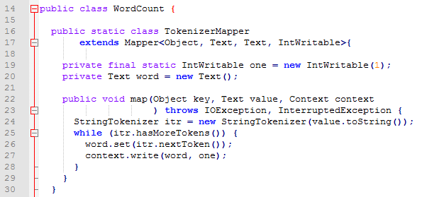
Word Count in java: Mapper

Slide 41
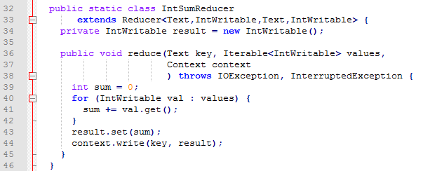
Word Count in java: Reducer

Slide 42
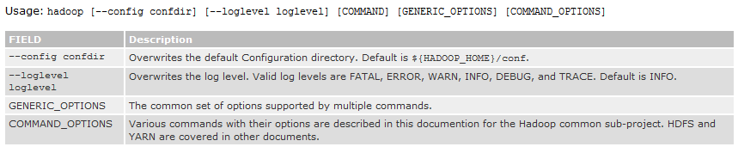
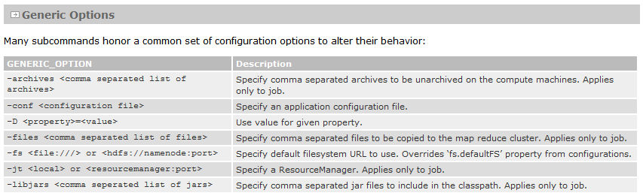
Overview: Hadoop Commands
Documentation: https://hadoop.apache.org/docs/stable/hadoop-project-dist/hadoop-common/CommandsManual.html

Slide 43
Optional: Hadoop in single mode required!

Slide 44
First Hadoop-Job: Wordcount
A classical example (Hadoop provides several examples, we will find out which) is to count words in documents
We can do this using the wordcount example:
Wordcount:
hadoop jar /usr/local/hadoop/share/hadoop/mapreduce/hadoop-mapreduce-examples-2.9.2.jar wordcount
Input-/Output-Files:
hadoop jar /usr/local/hadoop/share/hadoop/mapreduce/hadoop-mapreduce-examples-2.8.5.jar wordcount <Input-File / Folder> <Output-Folder>
If you run Hadoop in Single Mode, HDFS will not be used!

Slide 45
Small Example - Run Hadoop in Single Mode
Run the following commands in your home directory:
# Create folder h.examples
mkdir ~/h.examples
cd ~/h.examples
# Built these two small files:
echo "cat sat mat" > 1.txt
echo "dog lay mat" > 2.txt
hadoop jar /usr/local/hadoop/share/hadoop/mapreduce/hadoop-mapreduce-examples-2.9.2.jar wordcount ~/basicHadoopExample ~/results
Documentation: https://hadoop.apache.org/docs/stable/hadoop-project-dist/hadoop-common/SingleCluster.html

Slide 46
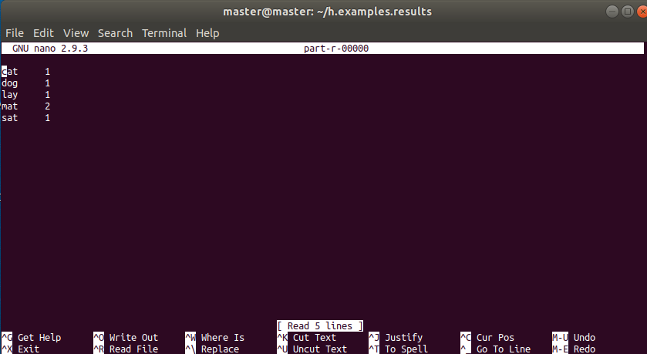
Results

Slide 47
YARN

Slide 48
YARN
The fundamental idea of YARN is to split up the functionalities of resource management and job scheduling/monitoring into separate daemons.
The idea is to have a global ResourceManager (RM) and per-application ApplicationMaster (AM). An application is either a single job or a DAG of jobs.
Documentation: https://hadoop.apache.org/docs/stable/hadoop-yarn/hadoop-yarn-site/YARN.html

Slide 49
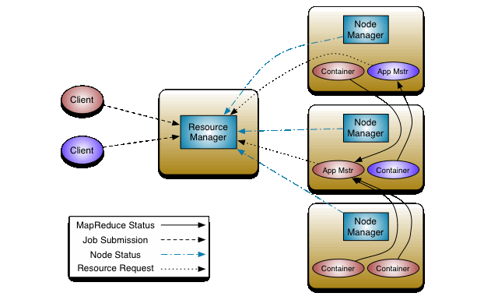
YARN

Slide 50
Hadoop in Pseudo-Distributed Mode
Pseudo-distributed mode is when you have all the Hadoop components running on a single host (A. Holmes, 2016)

Slide 51
Running Hadoop Jobs
Single Modes
1
Standalone (or local) mode
There are no daemons used in this mode.
Hadoop uses the local file system as an substitute for HDFS file system.
The jobs will run as if there is 1 mapper and 1 reducer.
Distributed Modes
2
Pseudo-distributed mode
All the daemons run on a single machine and this setting mimics the behavior of a cluster.
All the daemons run on your machine locally using the HDFS protocol.
There can be multiple mappers and reducers.
3
Fully-distributed mode
This is how Hadoop runs on a real cluster.

Slide 52
Overview: Setup Files
hosts (ipaddress)
.bashrc(Java dir, home dir)
hadoopconfiguration files in /usr/local/hadoop/etc/hadoop/
hadoop-env.sh (Java dir)
core-site.xml (default file system)
hdfs-site.xml (replication factor)
mapred-site.xml (mapreduceframework)
yarn-site.xml (nodemanageraux-services)
master/slave (IPs for multi-node cluster)
Documentation: https://hadoop.apache.org/docs/stable/hadoop-project-dist/hadoop-common/SingleCluster.html

Slide 53
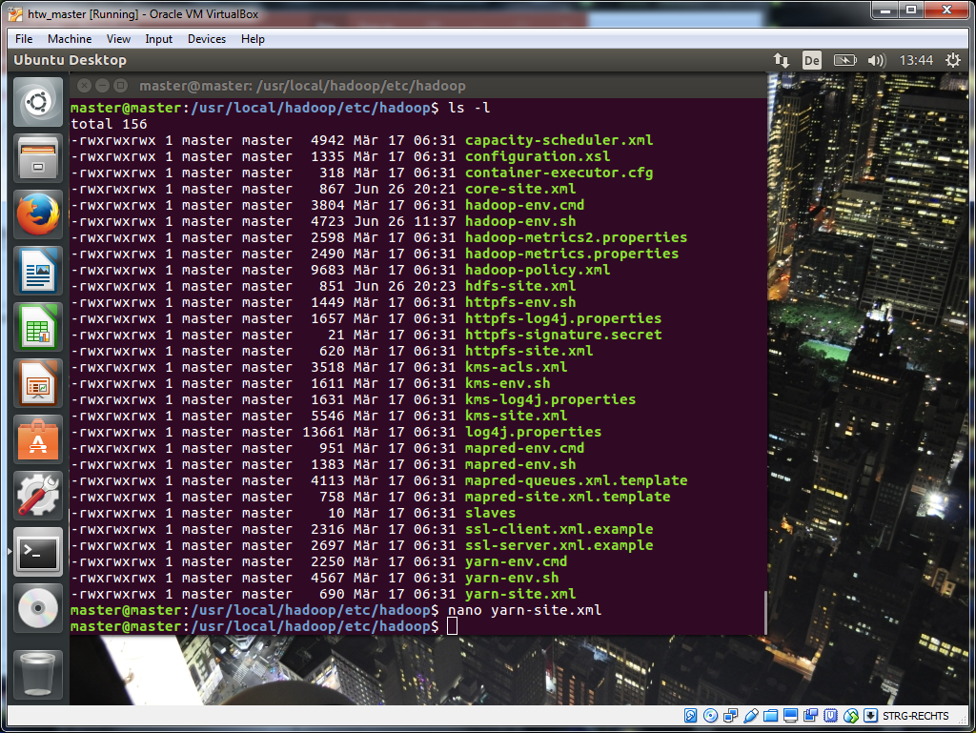
Overview: Setup Files

Slide 54
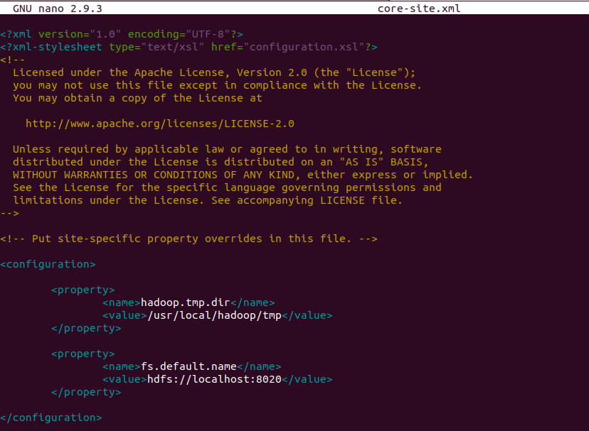
core-site.xml - Configuration

Slide 55
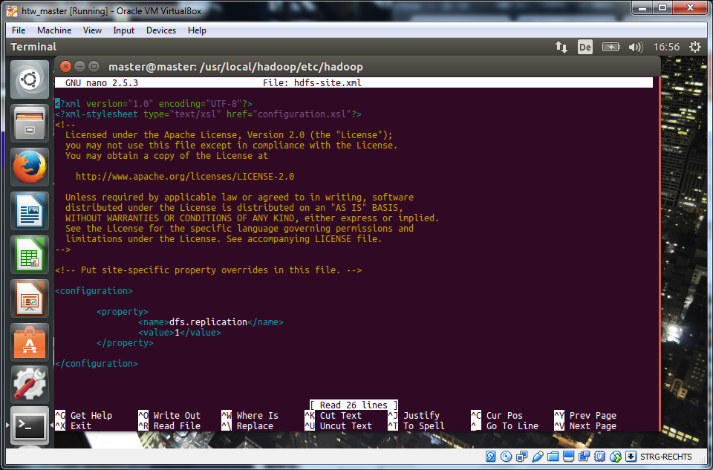
hdfs-site.xml - Configuration

Slide 56
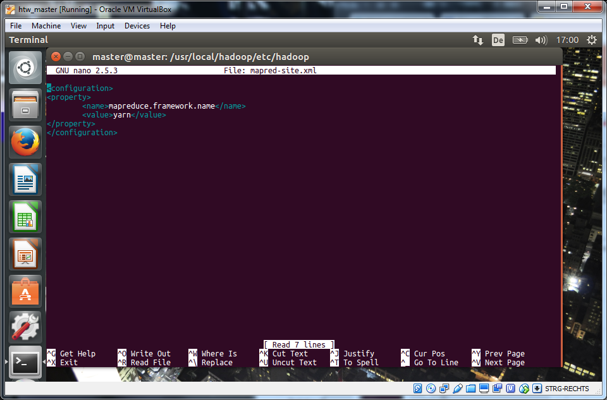
mapred-site.xml - Configuration

Slide 57
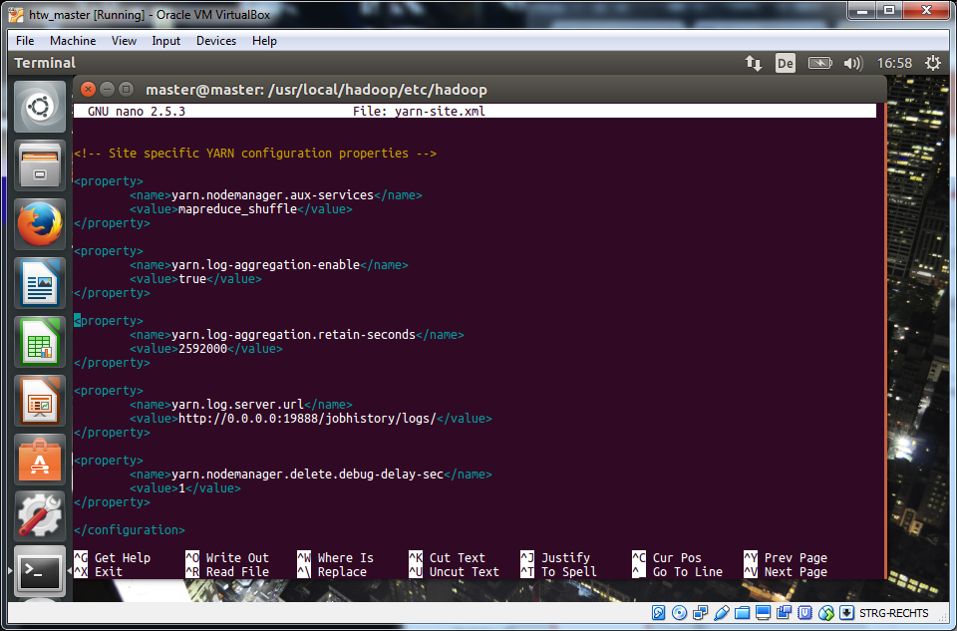
yarn-site.xml – Configuration
First try it without these modifications!

Slide 58
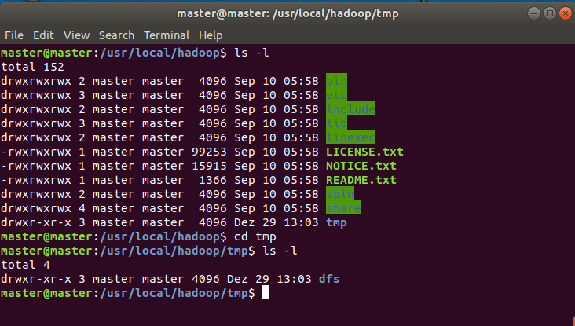
tmp-Folder

Slide 59
Option 1 - (2) Start all Services: Please use the script on Desktop: hadoop_startup.sh
Ubuntu console:
# 2. The following commands are required to start Hadoop 2
yarn-daemon.sh start resourcemanager
yarn-daemon.sh start nodemanager
hadoop-daemon.sh start namenode
hadoop-daemon.sh start datanode
[mr-jobhistory-daemon.sh start historyserver]
[hadoop-daemon.sh start secondarynamenode]
jps # should show DataNode and NameNode, NodeManager, ResourceManager, JobHistoryServer

Slide 60
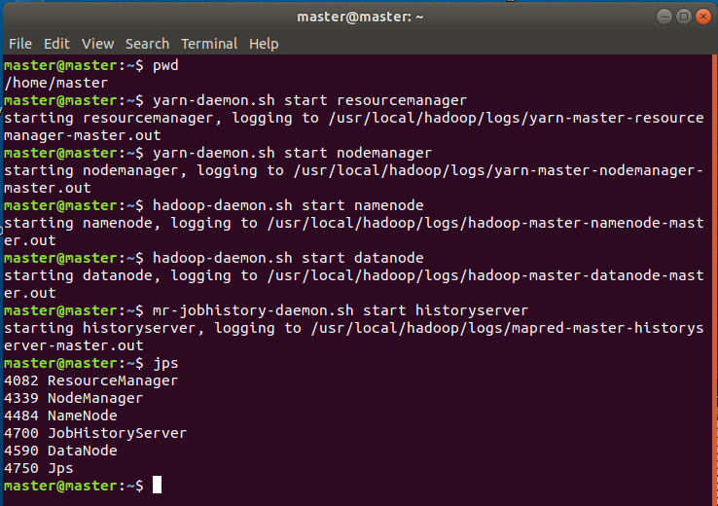
Option 1 - (2) Start all Services

Slide 61
Check Daemons
Ubuntu Console
jps

Slide 62
Interfaces: HDFS and Application Tracker
1
Cluster status and jobs
http://localhost:8088
2
HDFS
http://localhost:50070
3
Jobhistory Server
http://localhost:19888

Slide 63
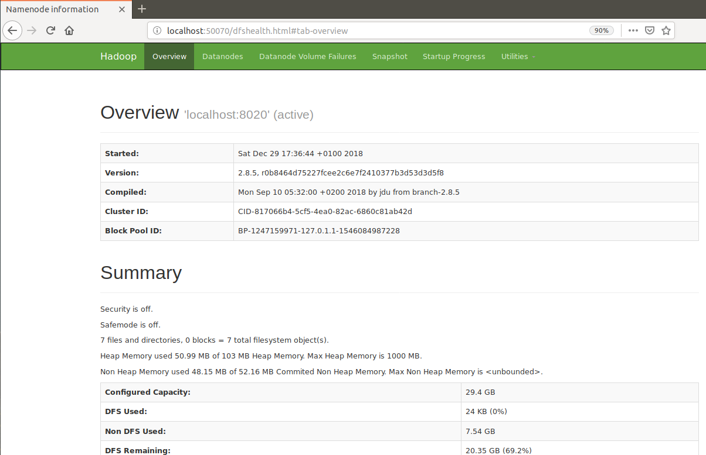
HDFS: Browse the web interface for the NameNode: default: http://localhost:50070

Slide 64
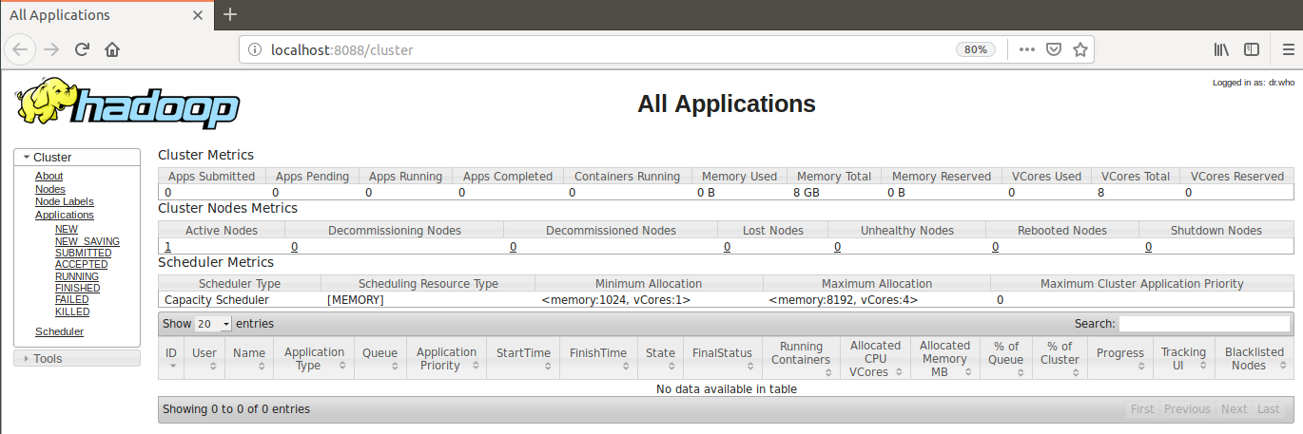
Application Tracker [Port 8088]

Slide 65
Exercise: Make yourself familiar with the different system frontends!
HDFS: Where can you find the HDFS filesystem?
Which files are in the system currently
How many space is available?
Health status of the system?
…
Application Tracker
Are there any applications? (Old ones?)
How many nodes are available?
…

Slide 66
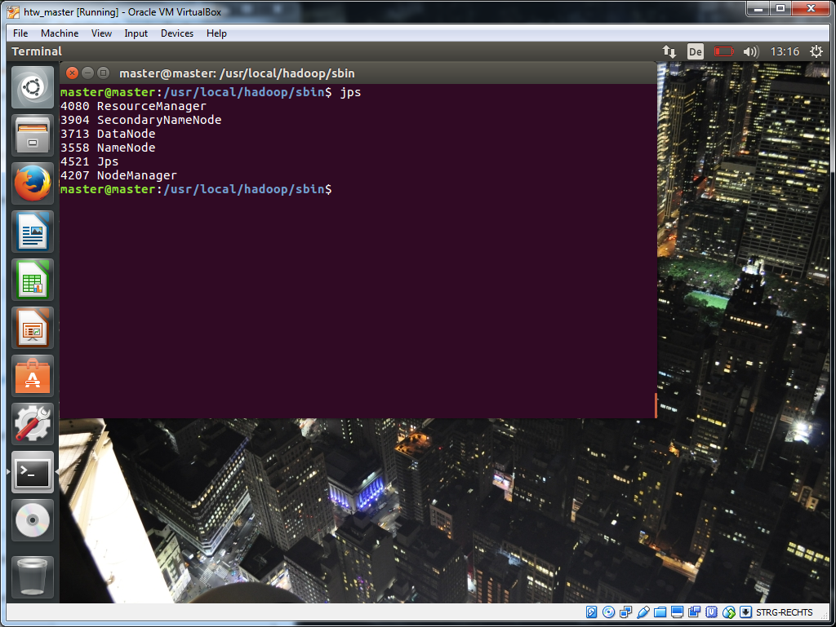
Check Daemons

Slide 67
Lab 2: Top-10 R-packages in January 2016
We will use the RStudio CRAN Log-files (freely available from RStudio webpage) to figure out the Top-10 R-packages in January 2016.
File: packages_01.2016.txt
The file is already prepared to use it directly in Hadoop Single Mode!
File size is approx 146 MB!
Run a word-count on the file
Export the results back to the host OS
Use R/RStudio to sort the file and display the Top-10 results
Generate a table and a bar chart in R

Slide 68
hdfs

Slide 69
Check Content of HDFS Directories - required to execute MapReduce Jobs
Ubuntu console:
<username>: master
# Check the directories
hdfs dfs –ls /

Slide 70
(5) Copy Input Files into Distributed Filesystem
Ubuntu console:
# Copy specific file t8.shakespeare.txt into folder /user/master/
./hdfs dfs -put ~/Downloads/t8.shakespeare.txt /user/master/
# Check content
./hdfs dfs –ls /user/master

Slide 71
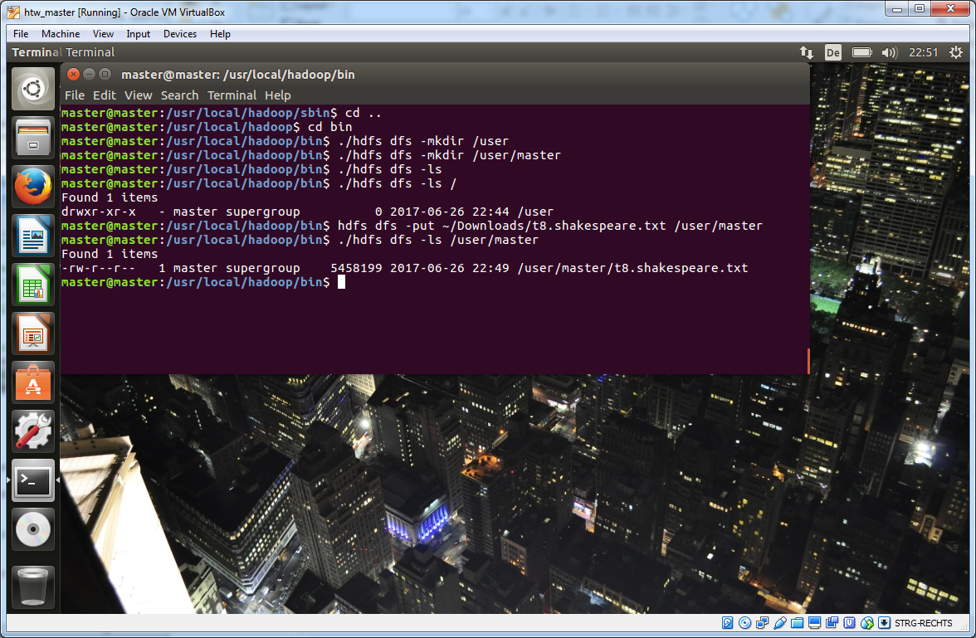
(5) Copy Input Files into Distributed Filesystem

Slide 72
Wordcount on a pseudo-distributed system

Slide 73
(6) Run wordcount
Ubuntu console:
# Check if it works
hadoop jar /usr/local/hadoop/share/hadoop/mapreduce/hadoop-mapreduce-examples-2.8.5.jar wordcount
# Run with input file
hadoop jar /usr/local/hadoop/share/hadoop/mapreduce/hadoop-mapreduce-examples-2.8.5.jar wordcount /user/master/t8.shakespeare.txt out1

Slide 74
(7) Examine Output Files
Ubuntu Console:
# Inspect hdfs
hdfs dfs –ls /user/master
hdfs dfs –ls /user/master/out2/
# Copy from hdfs to normal filesystem
hdfs dfs –get /user/master/out2 ~/out2
# Inspect results
cd ~/out2
ls –l
more part-r-00000

Slide 75
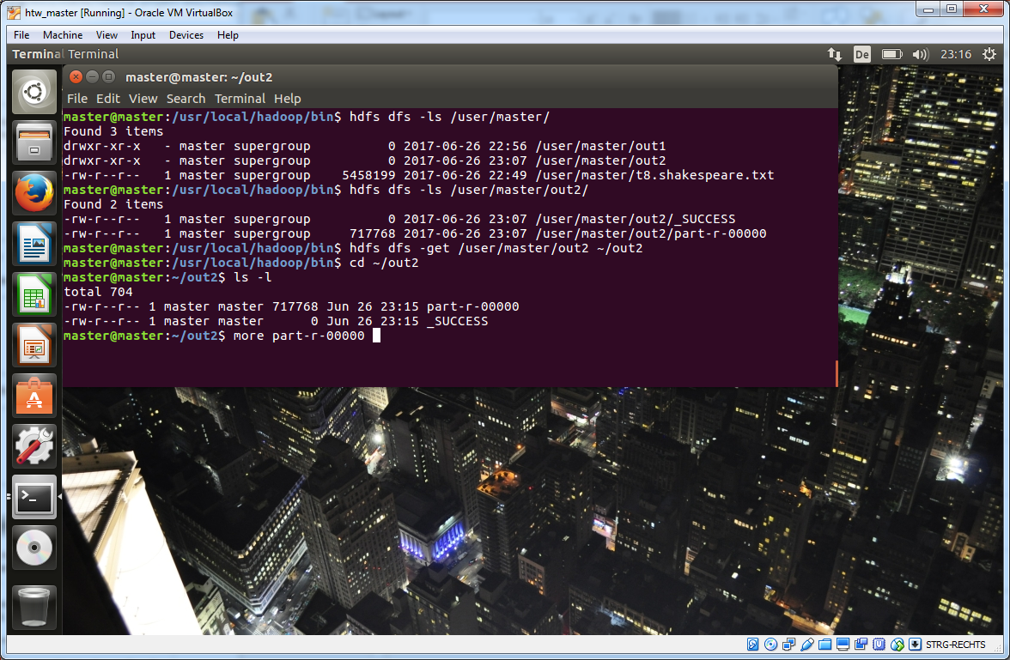
(7) Examine Output Files

Slide 76
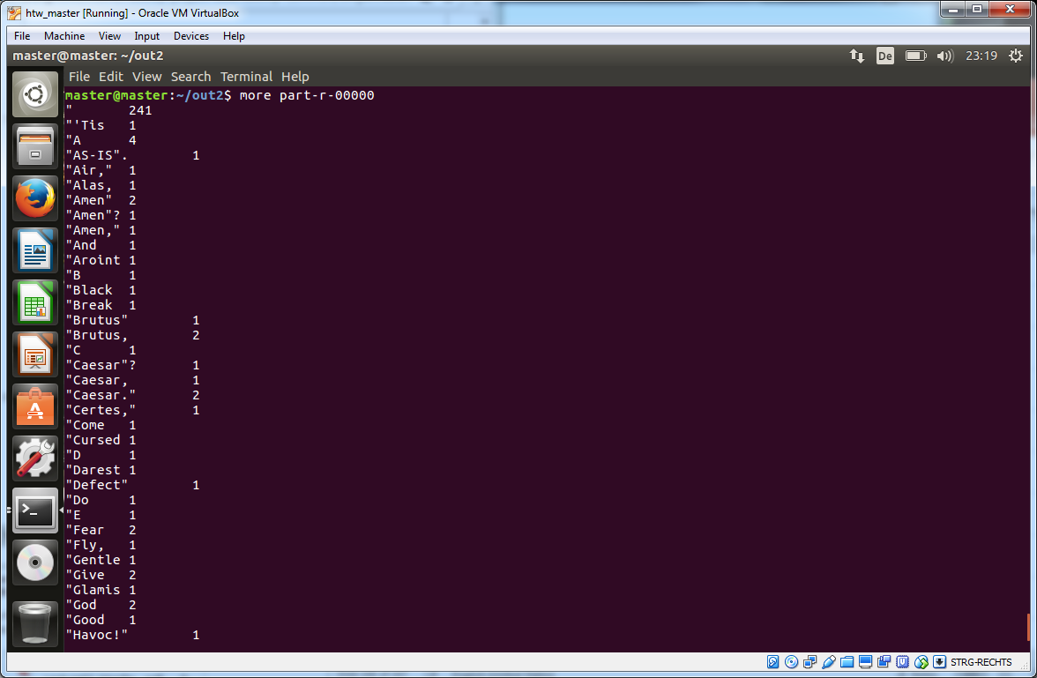
(7) Examine Output Files

Slide 77
LAB: Analyse works of shakespeare

Slide 78
Download Shakespeare (~ 5.2 MB)
Browser:
# Shakespeare: https://ocw.mit.edu/ans7870/6/6.006/s08/lecturenotes/files/t8.shakespeare.txt
<Right click and save page as t8.shakespeare.txt in ~/Downloads-Folder>
Ubuntu console:
# Shakespeare:
cd ~/Downloads
wget https://ocw.mit.edu/ans7870/6/6.006/s08/lecturenotes/files/t8.shakespeare.txt

Slide 79
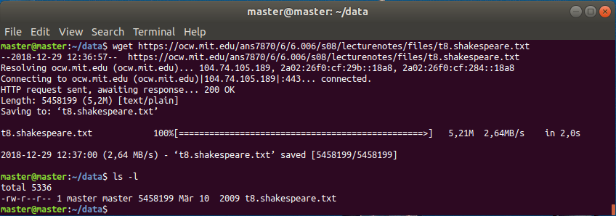
Download Shakespeare

Slide 80
TASK
Run a wordcount on the complete works of Shakespeare you just downloaded! Use Hadoop in Single Mode!

Slide 81
Stop hadoop system

Slide 82
Notes
Only stop the whole system if you want to do changes will require a not running system!
In all other cases use the virtual box and simply freeze the system!

Slide 83
(8) Option 1 - Stop Daemons: Use Script hadoop_stop.sh on Desktop!
Ubuntu console:
cd /usr/local/hadoop/sbin
mr-jobhistory-daemon.sh stop historyserver
hadoop-daemon.sh stop datanode
hadoop-daemon.sh stop namenode
hadoop-daemon.sh stop secondarynamenode
yarn-daemon.sh stop nodemanager
yarn-daemon.sh stop resourcemanager
# Check if anything is running
jps

Slide 84
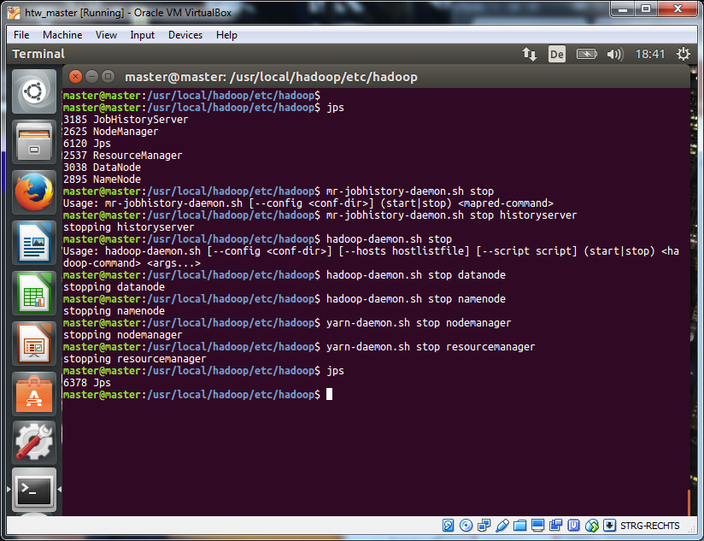
(8) Option 1 - Stop Daemons

Slide 85
(8) Option 2 - Stop Daemons
Ubuntu console:
cd /usr/local/Hadoop/sbin
./stop-dfs.sh
./stop-yarn.sh
jps

Slide 86
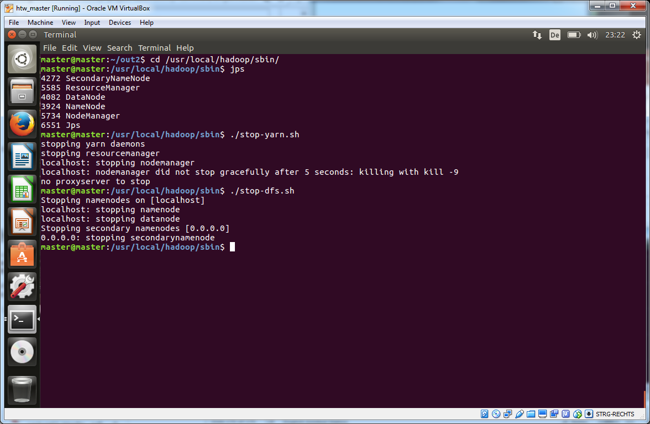
(8) Stop Daemons

Slide 87
HDFS – Introduction

Slide 88
HDFS – Short Intro
HDFS: Hadoop Distributed File System
HDFS Web Interfaces: http://localhost:50070

Slide 89
HDFS Command Line

Slide 90
Hadoop Command Line - Overview
Explain how to invoke the HDFS shell
List the HDFS commands

Slide 91
HDFS File Command Interface
The FileSystem (FS) shell is invoked by
hdfs dfs <args>
Example to list the current directory in HDFS
hdfs dfs -ls

Slide 92
HDFS File Command Interface
All FS shell commands take path URIs as arguments
scheme://authority/path
Scheme
Scheme for HDFS is hdfs
Scheme for local filesystem is file
hdfs dfs -cp
file:///sampleData/spark/myfile.txt
hdfs://master:8020/user/spark/test/myfile.txt
Scheme and Authority are optional
Defaults are taken from the core-site.xml configuration file
Most of the FS shell commands behave like corresponding UNIX commands!

Slide 93
HDFS File Commands
A number of POSIX-like commands
cat, chgrp, chmod, chown, cp, du, ls, mkdir, mv, rm, stat, tail
Some HDFS-specific commands
copyFromLocal, copyToLocal, get, getmerge, put, setrep

Slide 94
HDFS – Specific Commands
copyFromLocal / put
Copy files from the local filesystem to HDFS
copyToLocal / get
Copies files from HDFS to the local filesystem
getMerge
Get all files in the directory that match the source pattern
Merges and sorts them to only one file on local filesystem
setRep
Sets the replication factor of a file
Can be executed recursively to change an entire tree
Can specify to wait until the replication level is achieved

Slide 95
HDFS Shell
hdfs dfsadmin –help
All admin commands
hdfs dfs -help
All commands
Important: Most commands similar to unix!
Unix: ls → HDFS: hdfs dfs -ls

Slide 96
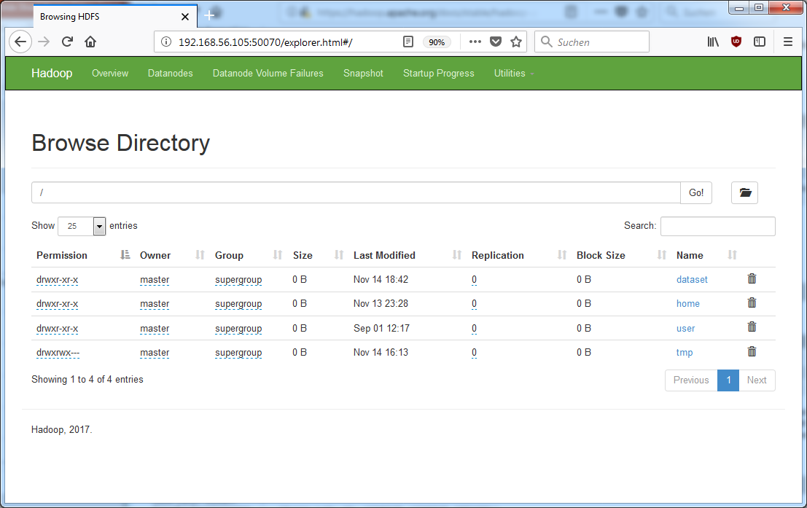
Web Interface: Utilities > Browse the file system [Port 50070]

Slide 97
Case Study 1

Slide 98
Analyze RStudio CRAN Log-Files
Analyse – in groups up to 2 persons – RStudio CRAN Log Files – January 2016
Log-Files:
There is one log-file (uploaded in Moodle)
Log file have been modified: only package-name inside
Tasks:
Import log-files into HDFS
Use Hadoop wordcount to analyze package frequency in January 2016
Export out of HDFS
Visualize in R / Tableau or Python
Display the distribution

Slide 99
Structure of the data set
Version 1: complete Log-File
Version 2: only package names
We will use Version 2 in this case!

Slide 100
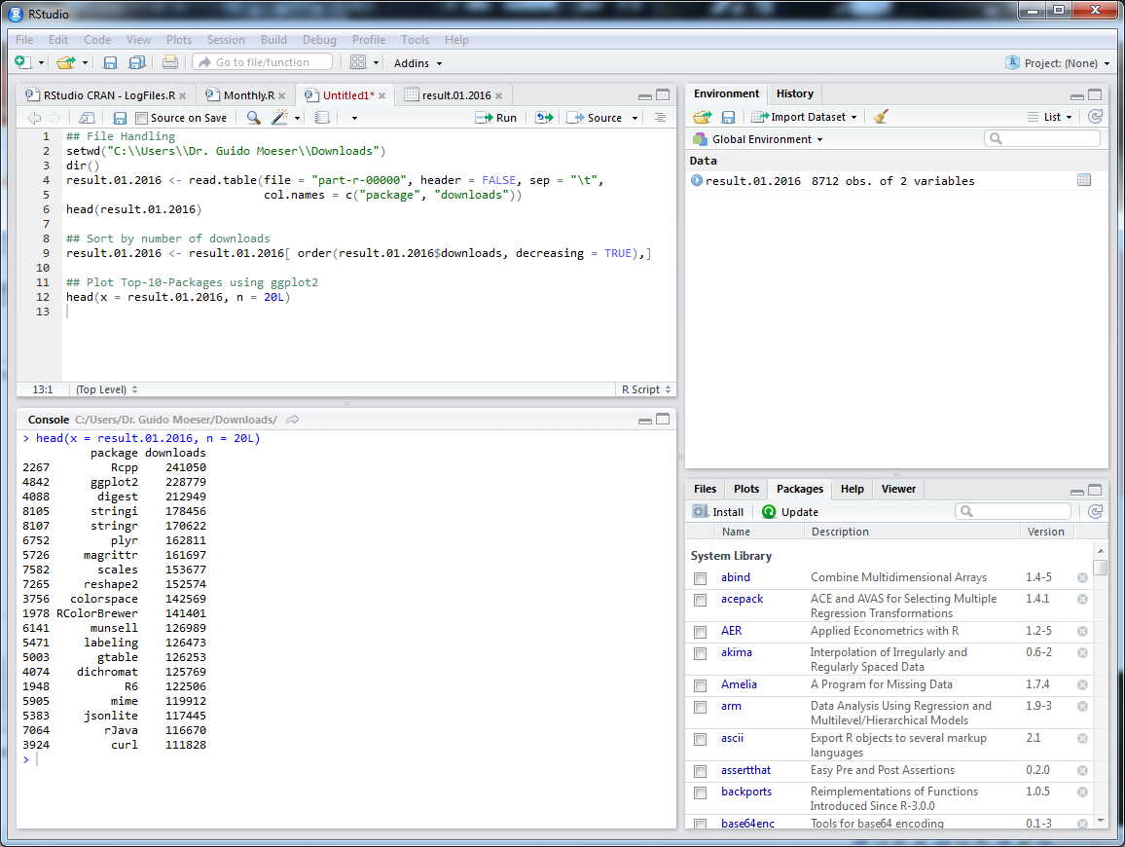
Results in RStudio

Slide 101
Results in MS Excel

Slide 102
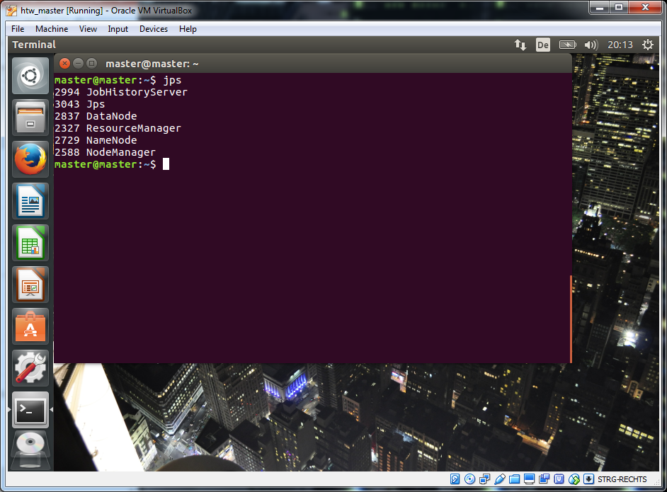
Example: 1/2016 – Start Hadoop-Services; use jps to check it!

Slide 103
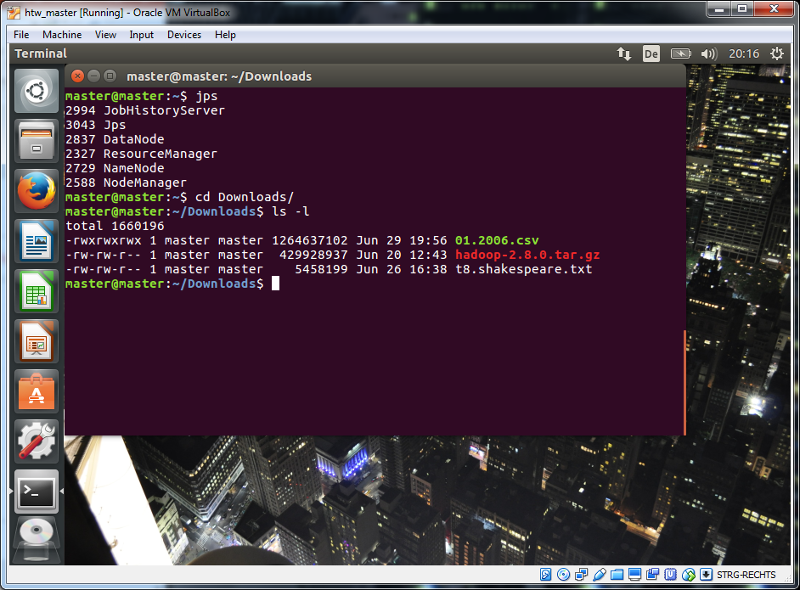
Use Shared-Folder to copy dataset from Host-System

Slide 104
Load dataset into HDFS
Ubuntu Console:
hdfs dfs –put ~/Downloads/01.2006.csv /user/master

Slide 105
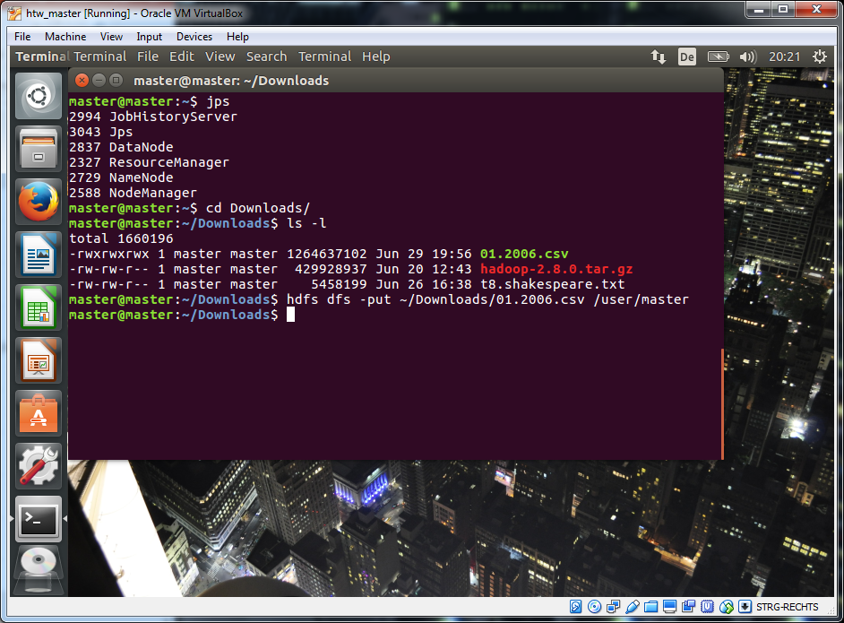
Load dataset into HDFS

Slide 106
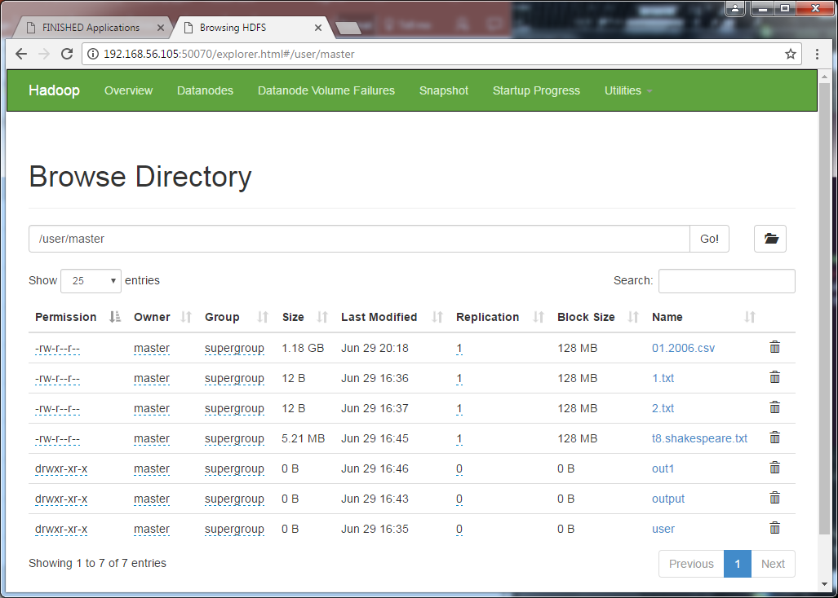
Check HDFS using Web-Interface

Slide 107
Start wordcount
Ubuntu Console:
hadoop jar /usr/local/hadoop/share/hadoop/mapreduce/hadoop-mapreduce-examples-2.8.5.jar wordcount 01.2006.csv /user/master/rout

Slide 108
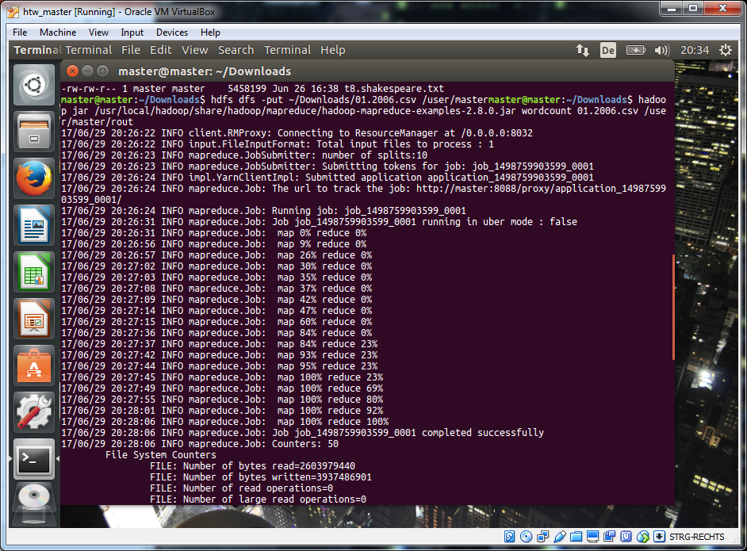
Start wordcount

Slide 109
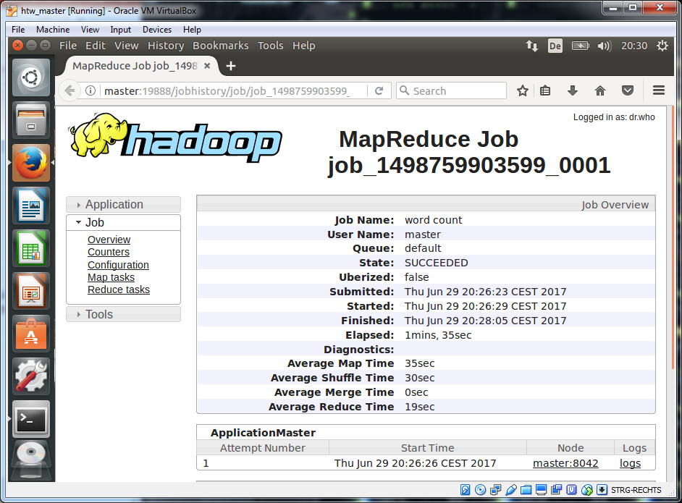
MapReduce Job

Slide 110
Extract Data from HDFS
Ubuntu Console:
hdfs dfs –get /user/master/rout ~/rout

Slide 111
Hadoop Administration

Slide 112
Agenda
Adding and removing nodes from the cluster
Verifying cluster health
Stopping / starting components / services
Configuring Hadoop

Slide 113
Adding and removing nodes from the cluster
Need IP address or hostname of node to add
Node must be reachable
Eg: ssh 192.168.44.15
/etc/hosts on both master and child nodes should be updated prior to adding child nodes

Slide 114
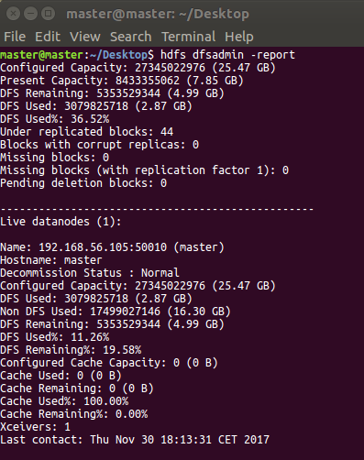
Verifying Cluster Health – Disk Space
Performed DFS Disk Check by running DFS Report
Helps determine if there is low disk storage
Run DFS Report using:
hdfs dfsadmin -report

Slide 115
Starting / Stopping Components
Not all components may need to be running!
Stopping some can save resources
See also start / stop scripts!
Check the status what is running using
jps

Slide 116
Configuration Files (1)
Filename | Description
hadoop-env.sh | Environment variables that are used in the scripts to run Hadoop
core-site.xml | Configuration settings for Hadoop Core, suche I/O settings that are common to HDFS and MapReduce
hdfs-site.xml | Configuration settings for HDFS daemons: the name node, secondary name node, and the data nodes.
mapred-site.xml | Configuration settings for MapReduce daemons and jobtracker, and tasktrackers
masters | A list of machines (one per line) that each run secondary NameNode
slaves | A list of machines (one per line) that each run data node and tasktracker

Slide 117
Configuration Files (2)
Filename | Description
hadoop-metrics.properties | Properties for controlling how metrics are published in Hadoop
log4j.properties | Properties for system logfiles, the NameNode audit log, and the task log for the tasktracker child process

Slide 118
hadoop-env.sh settings (1)
Most variables by default and not set!
Only export JAVA_HOME is required and should be set to java JDK
HADOOP_HOME – Contains code & config files
HADOOP_LOG_DIR – Keeps logs /usr/local/hadoop/logs

Slide 119
hadoop-env.sh settings (2)
HADOOP_HEAPSIZE – heap size used by JVM of each daemon
Can be overwritten for each daemon:
NameNode – Hadoop_NAMENODE_OPTS
DataNode – HADOOP_DATANODE_OPTS
Secondary NameNode – HADOOP_SECONDARYNAMENODE_OPTS
JobTracker – HADOOP_JOBTRACKER_OPTS
TaskTracker – HADOOP_TASKTRACKER_OPTS
Other environment variables: HADOOP_CLASSPATH, HADOOP_PID_DIR

Slide 120
core-site.xml Settings (1)
Parameter | Description
fs.defaultFS | The name of the default file system. A URI whose scheme and authority determine the FileSystem implementation. The URI‘s scheme determines the config property (fs.SCHEME.impl) naming the FileSystem implementation class. The URI‘s authority is used to determine the host, port, etc. for a filesystem. Default: file:///
log4j.properties | A base for other temporary directories. Default: /tmp/hadoop-${user.name}

Slide 121
core-site.xml Settings (2)
Parameter | Description
fs.trash.interval | Number of minutes between trash checkpoints. If zero, the trash feature is disabled (default). When greater than zero erased files will be inserted in .trash in user‘s home directory.
io.file.buffer.size | The size of buffer for use in sequence files. The size of this buffer should be a multiple of hardware page size (4096 on Intel x86), and it determines how much data is buffered during read and write operations.

Slide 122
hdfs-site.xml Settings
Parameter | Description
dfs.datanode.data.dir | Determines where on the local filesystem a DFS data node should store its blocks.
dfs.namenode.name.dir | Determines where on the local filesystem the DFS namenode should store the name table.
dfs.blocksize | HDFS block size. Default is 64 MB. Recommendation: Set block size to 128 MB or as appropriate for your data.

Slide 123
mapred-site.xml Settings (1)
Parameter | Description
mapreduce.jobtracker.hosts | Names a file that contains the list of nodes that may connect to the jobtracker. If value is empty, all hosts are permitted.
mapreduce.jobtracker.hosts.exclude | Names a file that contains the list of hosts that should be excluded by the jobtracker. If the value is empty, no hosts are excluded.
mapreduce.job.maxtaskfailures.per.tracker | The number of task-failures on tasktracker of a given job after which new tasks of that job aren‘t assigned to it. Default is 3.
Mapreduce.jobtracker.tasktracker.maxblacklists | The number of blacklists for a taskTracker by various jobs after which the task tracker could be a blacklist across all jobs. The tracker will be given a task later (after a day. The tracker will become a healthy tracker after a restart. Default is 4.

Slide 124
mapred-site.xml Settings (2)
Parameter | Description
mapreduce.job.reduces | The default number of reduce tasks per job. Typically set to 99% of the cluster‘s reduce capacity, so that if a node fails the reduces can still be executed in a single wave. Ignored when mapred.job.tracker is „local“. Default: 1 Recommendation: set it to 90%
mapreduce.map.speculative | If true, then multiple instances of some map tasks may be executed in parallel. Default: true
mapreduce.reduce.speculative | If true, then multiple instances of some reduce tasks may be executed in parallel. Default: true. Recommendation: false

Slide 125
mapred-site.xml Settings (3)
Parameter | Description
mapreduce.tasktracker.map.tasks.maximum | The maximum number of map tasks that will be run simultaneously by a task tracker. Default: 2 Recommendation: set relevant to number of CPUs and amount of memory on each data node.
mapreduce.tasktracker.reduce.tasks.maximum | The maximum number of reduce tasks that will be run simultaneously by a task tracker. Default: 2 Recommendations: set relevant to number of CPUs and amount of memory on each data node.
mapreduce.jobtracker.taskscheduler | The class responsible for scheduling the tasks. Default points to FIFO scheduler. Recommendation: Use Job Queue Task – org.apache.hadoop.mapred.JobQueueTaskScheduler

Slide 126
mapred-site.xml Settings (4)
Parameter | Description
mapreduce.jobtracker.restart.recover | Recover failed job when JobTracker restarts. For production clusters recommended to be set to TRUE.
mapreduce.cluster.local.dir | The local directory where MapReduce stores intermediate data files. May be a comma-separated list of directories on different devices in order to spread disk i/o. Directories that do not exist are ignored. Default: ${hadoop.tmp.dir}/mapred/local

Slide 127
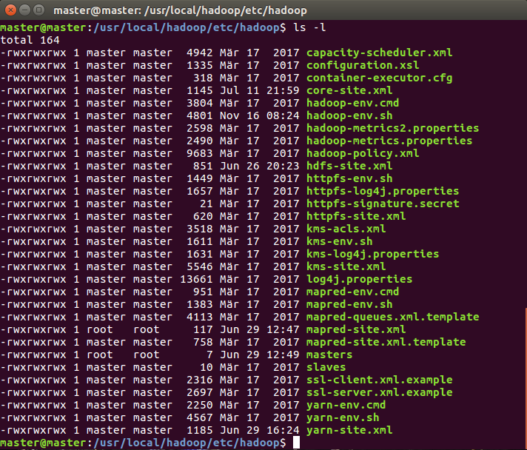
Configuring Hadoop - Example
Stop appropriate services before making the change
Change to the conf directory, look for hdfs-site.xml – here: /usr/local/hadoop/etc/hadoop/
Open hdfs-site.xml in editor

Slide 128
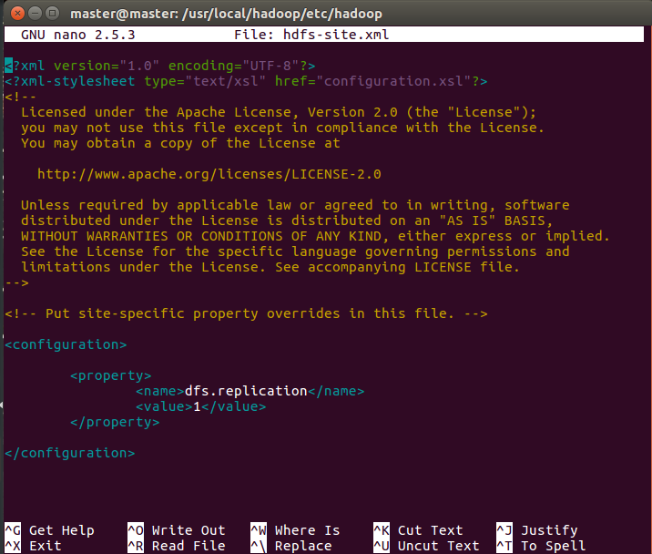
Configuring Hadoop - Example
sudo nano /usr/local/hadoop/etc/hadoop/hdfs-site.xml

Slide 130
Hadoop Architecture & HDFS

Slide 131
Learning Objectives
The main Hadoop components
How HDFS works
Data access patterns for which HDFS is designed
How data is stored in an HDFS cluster

Slide 132
Agenda
Discuss the components of Hadoop
Describe the different nodes in a Hadoop cluster
Explain the Hadoop replication process
Discuss how Hadoop uses rack awareness

Slide 133

Terminology Review
Node 1

Slide 134
Terminology Review
Node 1
Node 2
…
Node n

Slide 135
Terminology Review
Rack 1
Node 1
Node 2
…
Node n

Slide 136
Terminology Review
Rack 1
Rack 2
Node 1
Node 1
Node 2
Node 2
…
…
Node n
Node n

Slide 137
Terminology Review
Rack 1
Rack 2
Rack n
Node 1
Node 1
Node 1
…
Node 2
Node 2
Node 2
…
…
…
Node n
Node n
Node n

Slide 138
Terminology Review
Hadoop Cluster
Rack 1
Rack 2
Rack n
Node 1
Node 1
Node 1
…
Node 2
Node 2
Node 2
…
…
…
Node n
Node n
Node n

Slide 139
Pre Hadoop 2.2 Architecture
Hadoop Architecure & HDFS

Slide 140
Pre Hadoop 2.2 architecture
Two main components
Distributed File System
Hadoop Distributed File System (HDFS)
Map Reduce Engine
Framework for performing calculations on the data in the file system
Has a built-in resource manager and scheduler

Slide 141
Hadoop Distributed File System (HDFS)
HDFS runs on top of the existing file system
Not POSIX compliant
Designed to tolerate high component failure rate
Reliability is through replication!
Designed to handle very large files
Large streaming data access patterns
No random access
Uses blocks to store a file or parts of a file

Slide 142
HDFS file blocks
Not the same as the operating system‘s file blocks
HDFS book made up of multiple operating system blocks
Default for Hadoop is 64 MB
Recommended is 128 MB (check the Hadoop default value in your system!)
Size of a file can be larger than any single disk in the cluster
Blocks for a single file are spread across multiple nodes in the cluster
If a chunk of the file is smaller than the HDFS block size
Only the needed space is used
Blocks work well with replication

Slide 143
HDFS - Replication
Blocks with data are replicated to multiple nodes
Allows for node failure without loss of the data
Block #1
Node 1
Block #2
Node 3
Block #2
Block #3
Block #1
Node 2
Block #3

Slide 144
MapReduce Framework
Based on technology from Google
Processes huge datasets for certain kinds of distributable problems using a large number of nodes
A MapReduce program consists of map and reduce functions
Allows for distributed processing of the map and reduce operations
Tasks run in parallel

Slide 145
Type of Nodes – Overview – Hadoop V1 (outdated!)
Hadoop Cluster
DataNode
DataNode
Task Tracker
Task Tracker
Client
Job Tracker
NameNode
DataNode
DataNode
Task Tracker
Task Tracker

Slide 146
Types of Nodes - NameNode
NameNode
Only one per Hadoop Cluster
Manages the file system namespace and metadata
Data does not go through the NameNode
Data is not stored on the NameNode
Single Point of Failure
Good idea to mirror the NameNode
Do not use inexpensive, commodity hardware
Has large memory requirement
File system metadata is maintained in RAM to server read requests

Slide 147
Types of Nodes - DataNode
DataNode
Task Tracker
Many per Hadoop Cluster
Blocks from different files can be stored on the same DataNode
Manages blocks with data and serves them to clients
Periodically reports to NameNode the list of blocks it stores
Suitable for inexpensive, commodity hardware

Slide 148
Types of Nodes – JobTracker
Job Tracker
Manages the MapReduce jobs in the cluster
One per Hadoop Cluster
Receives job requests submitted by the client
Schedules and monitors MapReduce jobs on TaskTrackers
Attempts to direct a task to the TaskTracker where the data resides

Slide 149
Types of Nodes - TaskTracker
DataNode
Task Tracker
Many per Hadoop cluster
Executes the MapReduce operations
Runs the MapReduce tasks in JVMs
Have a set number of slots used to run tasks
Communicates with the JobTracker via heartbeat messages
Reads blocks from DataNodes

Slide 150
Hadoop > 2.2 Architecture
Hadoop Architecure & HDFS

Slide 151
Hadoop 2.2 Architecture
Provides YARN
Referred to as MapReduce V2
Resource Manager and Scheduler external to any framework
DataNodes still exist
JobTracker and TaskTracker no longer exist
Not a requirement to run YARN with Hadoop 2.2
Still supports MapReduce V1

Slide 152
YARN – Two main ideas
Provide generic scheduling and resource management
Support more than just MapReduce
Support more than just batch processing
More efficient scheduling and workload management
No more balancing between map slots and reduce slots
API
MapReduce
Pig
Hive
HBase
Giraph
Storm
Processing Framework
MapReduce v2
Tez
Hoya
Resource Management
YARN
Distributed Storage
HDFS

Slide 153
YARN Overview
Client
Resource Manager
Client
Node Manager
Node Manager
Node Manager
Application Master
Container
Application Master
Container
Container
Container
Container
Container

Slide 154
Hadoop High Availability
JournalNode
JournalNode
JournalNode
NameNode
NameNode
DataNode
DataNode
DataNode
DataNode

Slide 155

Hadoop Federation: Two main layers in HDFS
Namespace
Consists of directories, files and blocks
It supports all the namespace related file system operations such as create, delete, modify and list files and directories.
Block Storage Service has two parts
Block Management (which is done in Namenode)
Provides datanode cluster membership by handling registrations, and periodic heart beats.
Processes block reports and maintains location of blocks.
Supports block related operations such as create, delete, modify and get block location.
Manages replica placement and replication of a block for under replicated blocks and deletes blocks that are over replicated.
Storage - is provided by datanodes by storing blocks on the local file system and allows read/write access.
Web: https://hadoop.apache.org/docs/r2.4.1/hadoop-project-dist/hadoop-hdfs/Federation.html

Slide 156

Hadoop Federation: Multiple Namenodes / Namespaces
Web: https://hadoop.apache.org/docs/r2.4.1/hadoop-project-dist/hadoop-hdfs/Federation.html
Notes:
In order to scale the name service horizontally, federation uses multiple independent Namenodes/namespaces. The Namenodes are federated, that is, the Namenodes are independent and don’t require coordination with each other. The datanodes are used as common storage for blocks by all the Namenodes. Each datanode registers with all the Namenodes in the cluster. Datanodes send periodic heartbeats and block reports and handles commands from the Namenodes.

Slide 157
Block Pool
Block Pool
A Block Pool is a set of blocks that belong to a single namespace.
Datanodes store blocks for all the block pools in the cluster.
It is managed independently of other block pools.
This allows a namespace to generate Block IDs for new blocks without the need for coordination with the other namespaces.
The failure of a Namenode does not prevent the datanode from serving other Namenodes in the cluster.
Namespace Volume
A Namespace and its block pool together are called Namespace Volume.
It is a self-contained unit of management.
When a Namenode/namespace is deleted, the corresponding block pool at the datanodes is deleted.
Each namespace volume is upgraded as a unit, during cluster upgrade.

Slide 158

Rack (Topology) Awareness
The administrator defines the topology using the topology.script.file.name property in core-site.xml

Slide 159

HDFS Architecture
https://hadoop.apache.org/docs/r2.6.0/hadoop-project-dist/hadoop-hdfs/HdfsDesign.html

Slide 160

HDFS - Replication

